Slide 1


SAP Self-Service BI Blitz Connect People to Information for Better Decisions
For SAP Partners & Internal use only

Slide 2

SAP Self-Service BI Blitz - Agenda
Day 1 Welcome
Enablement
Networking
Day 2
Breakfast/preparation
Call Blitz
Debrief Day 2
Day 3
Breakfast/preparation
Call Blitz
Blitz Debrief
Networking Dinner?
-- Breakfast
Welcome & Agenda
SAP BI strategy & portfolio Overview
SAP Self Service BI Sales Play
-- break
A demo is worth 1000words How to speed demo Visualization Starter Pack
Analytics LOB positioning
- working lunch
The winning call (cold calling technique)
-- break
Build your pitch + Role play

Slide 3

“Simplicity is the ultimate sophistication” - Leonardo DaVinci
2014 SAP AG. All rights reserved.

Slide 4

About the session
You
Know your Customer
Empathy
learning & unlearning
LOB-led
Notes:
it budget flattening to decline, lob budget 20% cagr

Slide 5



Selling Analytics … Why Should You Care?
Internal
Use the hot BI topic to break into new accounts
Leverage BI to broaden your footprint within your accounts
Retire quota faster by attaching BI to any other systems
Create a healthy annuity business - BI investments are typically long-lived and grow organically. Frame up a staged analytics strategy that makes sense for your customers, and build downstream revenue
… and Protect your accounts start the analytics conversation before a competitor can

Slide 6
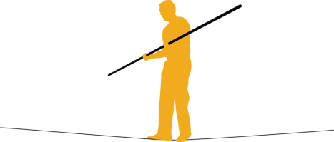







World is changing … the new Reality of LOB heads
Increasing Pressure & Greater Expectations
More effective management and better control
Outperform objectives and create value to the organization
Deliver quality products and services at a lower cost
Notes:
All of these issue impact the CFO and his team
{BUILD}
So more than ever, the CFO has to balance between sound stewardship and value creation, walking the proverbial fine line - always balancing between entrepreneurship and caution, between the big picture and accuracy in the details.
{BUILD}
Fulfilling the stewardship role by ensuring regulatory compliance and effective risk management – but no CFO is going to be recognized or rewarded for just doing that
{BUILD}
The expectation is that they add value by helping the organization to outperform stakeholder‘s financial expectations – generating more profit in the private sector or achieving more cost effective outcomes in the public sector
{BUILD}
And while doing so he/she needs to satisfy the requests from the organization for even higher service quality at further reduced cost.
{BUILD}
It is a real struggle with increasing pressures and while there is nothing fundamentally new with that picture, the stakes and challenges have gotten significantly higher in past years. Including the personal consequences of failure.

Slide 7

“Sell me this Pen”
“ … most average salespeople think that they’re supposed to sell you the pen, when a really seasoned salesperson will actually turn it into a qualifying session to find out what you need. That’s the truth of it.”
- Jordan Belfort (“The Wolf of Wall Street”)
https://www.youtube.com/watch?v=lPKm-dIIIkY#t=47

Slide 8
Self-Service BI – Core Value
The Customer Business Value:
Improve the customer’s business performance by giving them the power to connect people to data, and revolutionize the way they collectively make decisions across the organization.

Slide 9
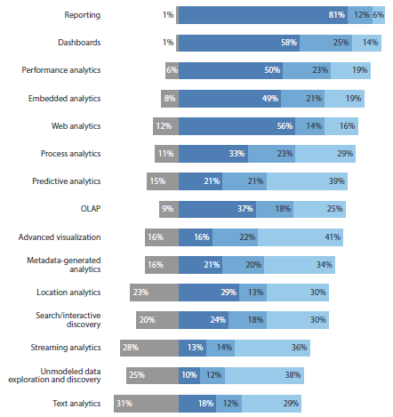

Why Self-Service BI? BI/Analytics adoption strengthening across all different technologies
Q. What is your current use of the following technologies?
Reporting (81%) and dashboards (58%) are the most highly adopted
63% planning to implement or are interested in advanced visualization
60% planning to implement or are interested in predictive analytics
Source: Forrester TechRadar™: BI Analytics, Q3 2013

Slide 10
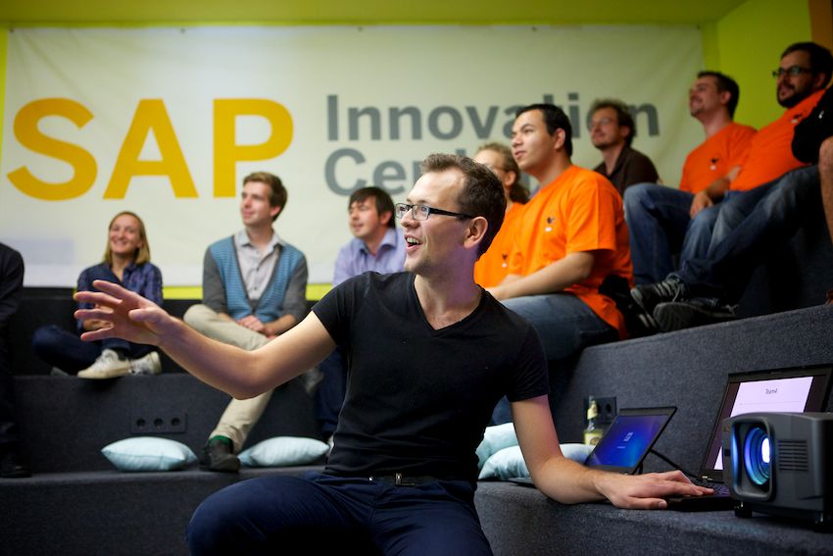
Talk Less … Do More
A Demo is worth a thousand words
Concepts are of little use if they stay put as words
Raze the wall between concept and facts

Slide 11
SAP Self-Service BI Blitz - Hosts
xxxxx
Partner Account manager –
XXXX
Partner Service Advisor -
Manuel Lopez
Sr. Director, Analytics – Global E&C
Xxxxxx
Director, Inside Sales Marketing

Slide 13
声明：
所有的版权属于原有公司，文件均来自公开渠道
此文件仅供学习使用，任何人不得进行以此为商业目的的行为
如有疑问，请立即删除
学习世界五百强和咨询公司PPT课程请访问如下网站搜索：“司马懿”
百度传课：司马懿PPT学校
网易学堂：司马懿PPT学校
知乎： 司马懿PPT学校
访问地址
https://www.chuanke.com
访问地址
https://study.163.com
访问地址
https://www.zhiu.com

